Slide 1
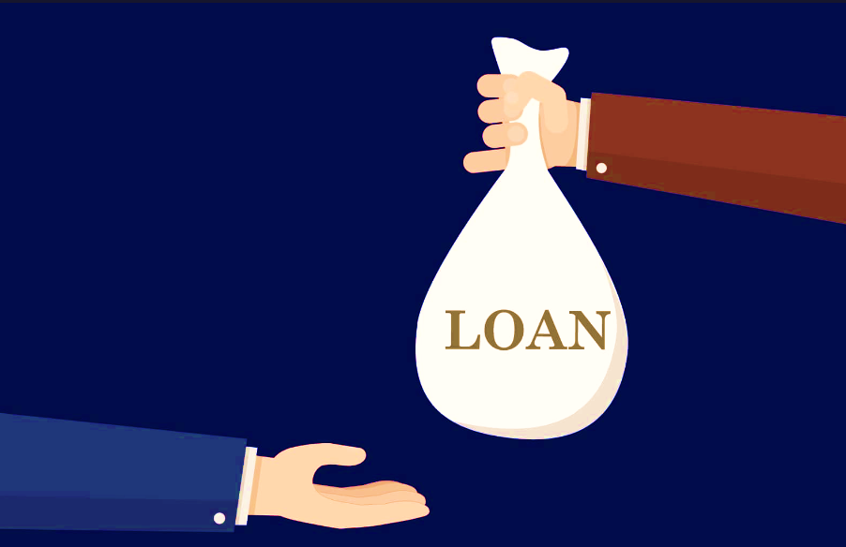
Accelerating Loan Approvals: Strategies for Success
CHAGANTI ANIL KUMAR REDDY

Slide 2
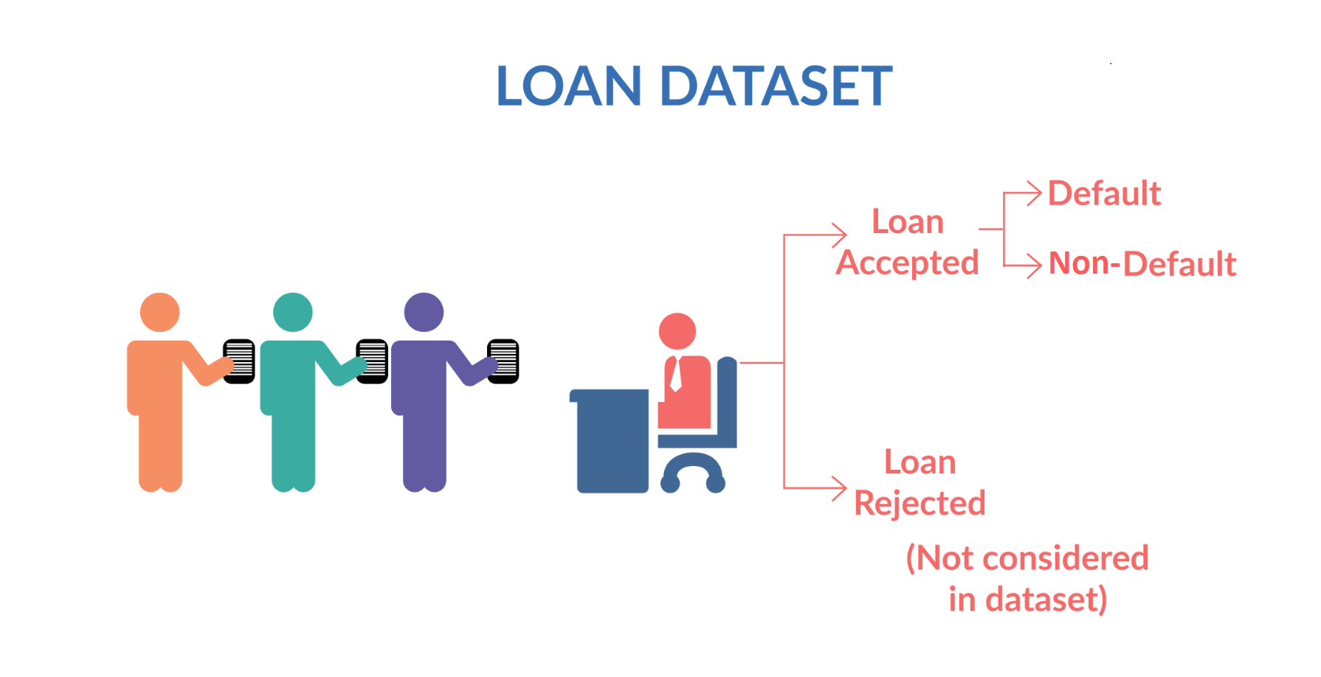
Effective Loan process
Problem statement :
Customer banks decision making whether to accept a loan or to reject it based on applicant eligibility criteria for loan attributes.
For apt decision making there are many Risk factors to be considered based on historical applicant data like credit score ,country code ,type of the loan ,salary and years of experience of the applicant and so on…
We have Two approaches to analyse historical data for above Risks and plotting out defaulters.
Univariant analysis : consider only one factor as variable
Bivariant analysis : consider two factors as variables

Slide 3
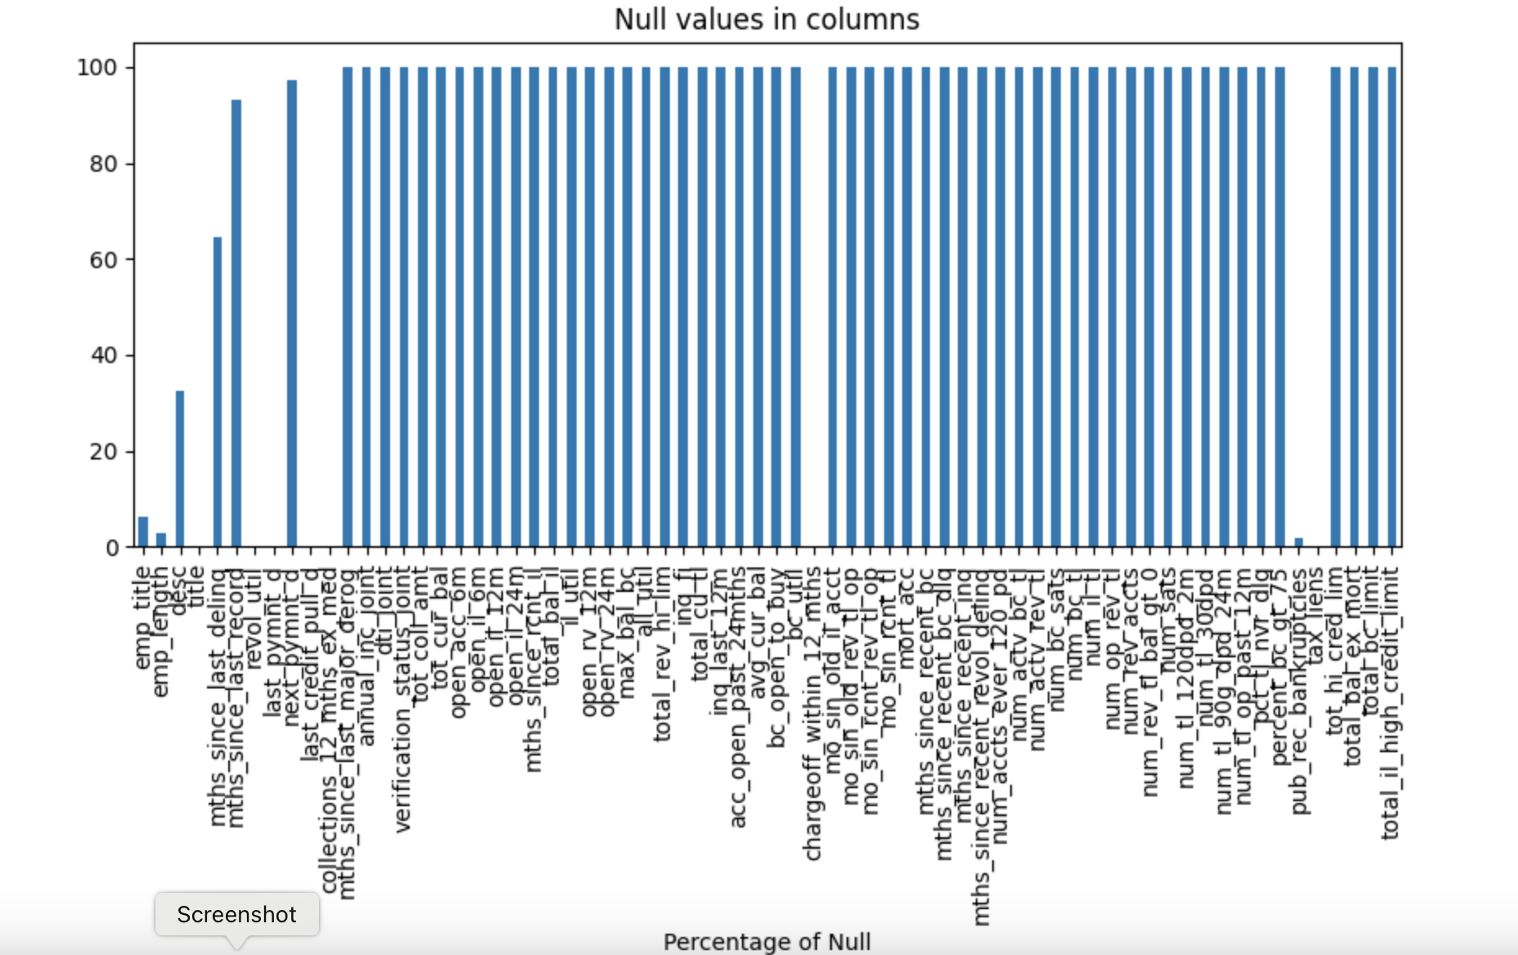
Data Cleaning process
We have used panda and numpy for data cleaning refer Data_cleaning_fof lending_loan_case.ipynb file for info
Here are the null value detail:

Slide 4
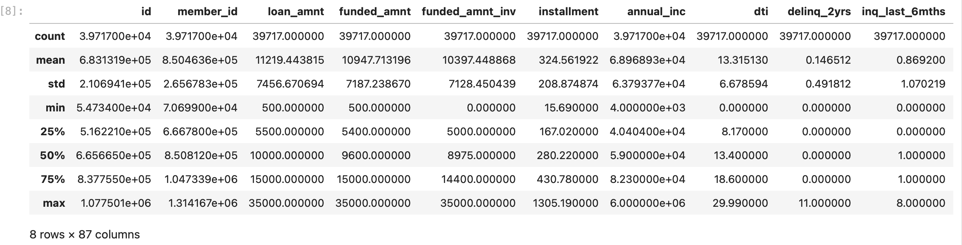
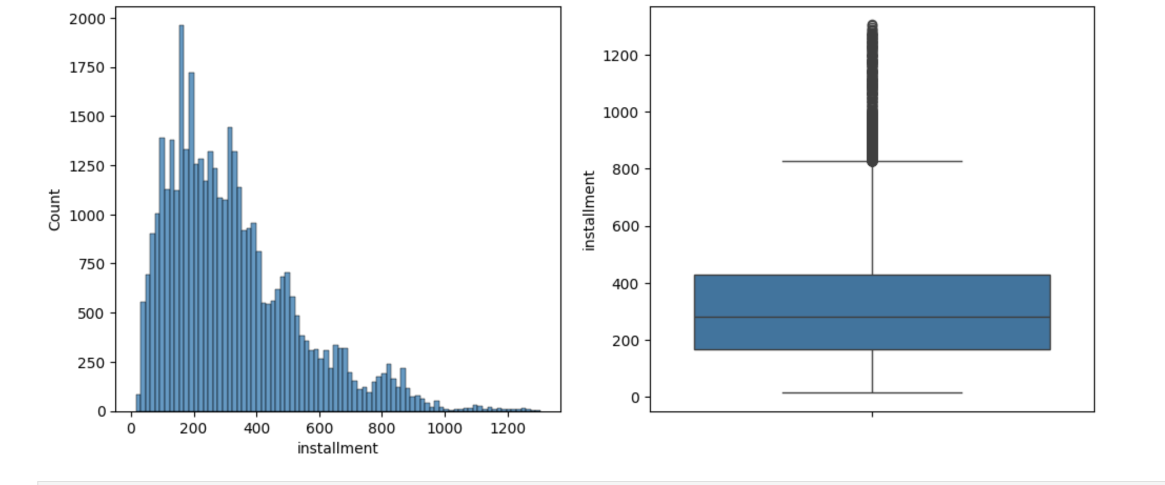
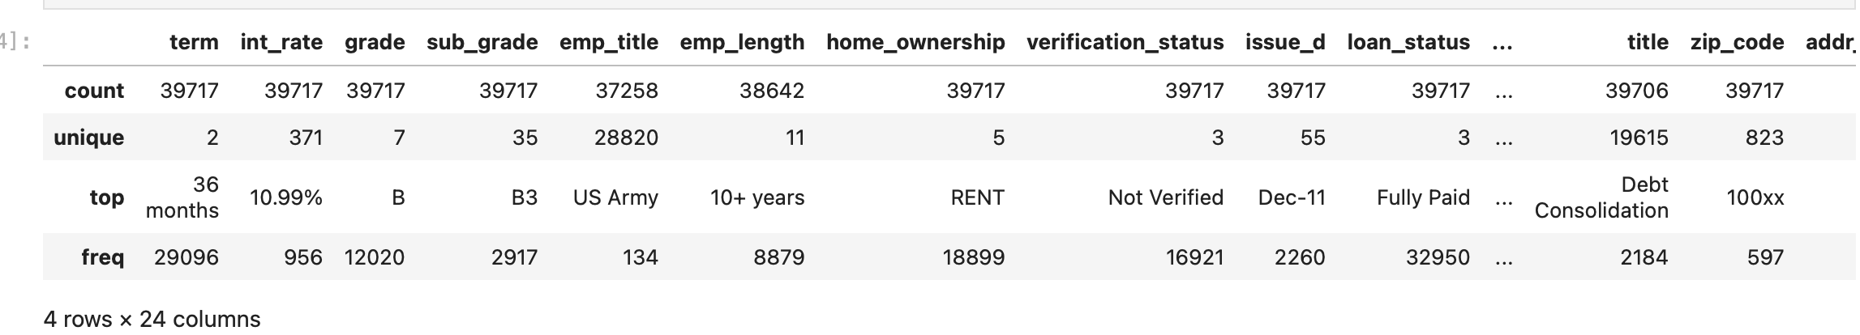
Categorizing data
We have categorize data
Using Numerical columns
Using Object type columns
Instalment count rough graph

Slide 5
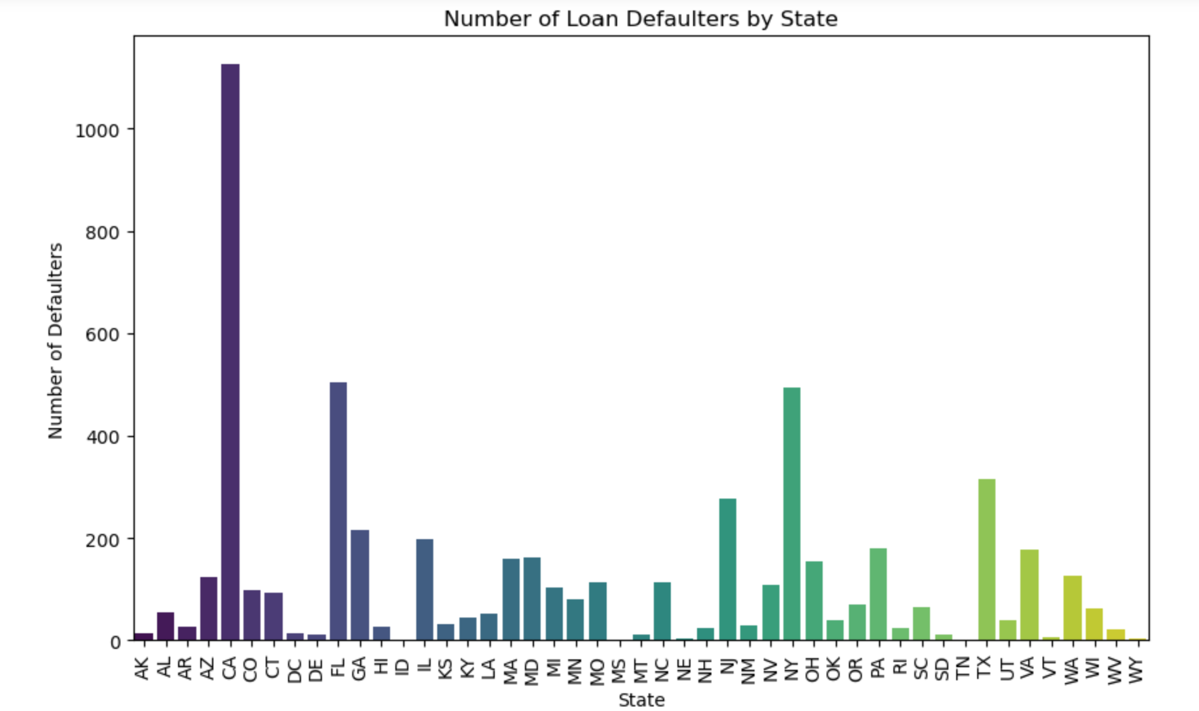
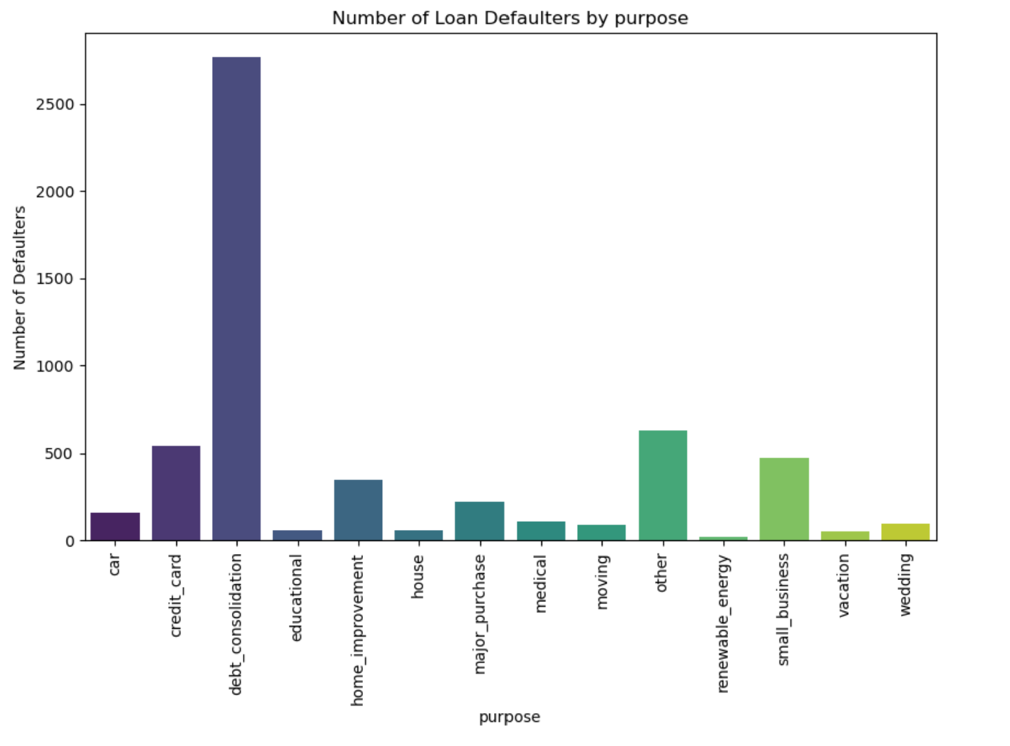
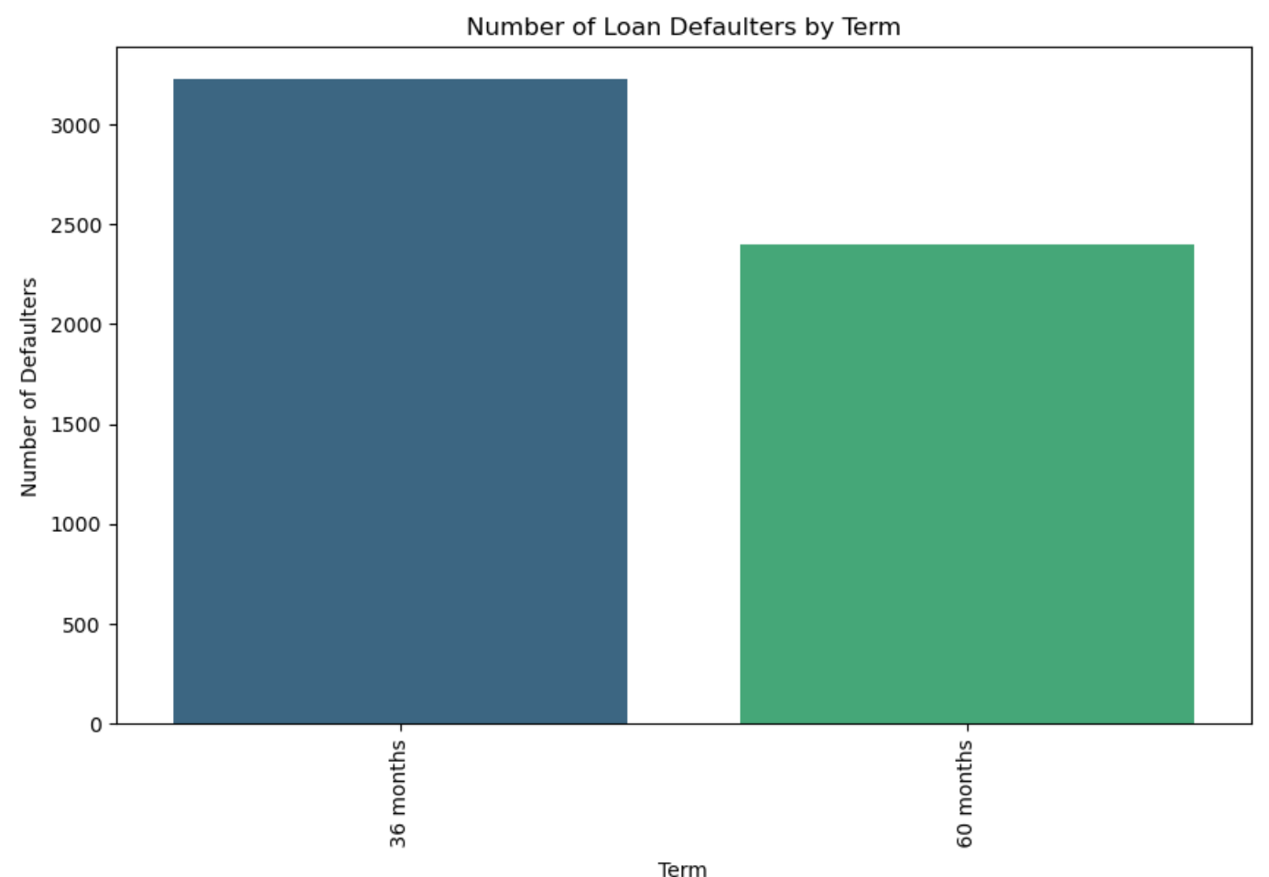
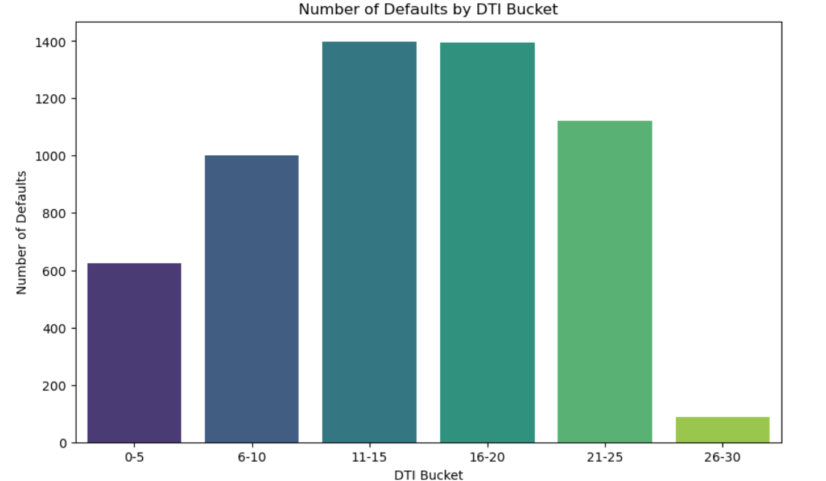
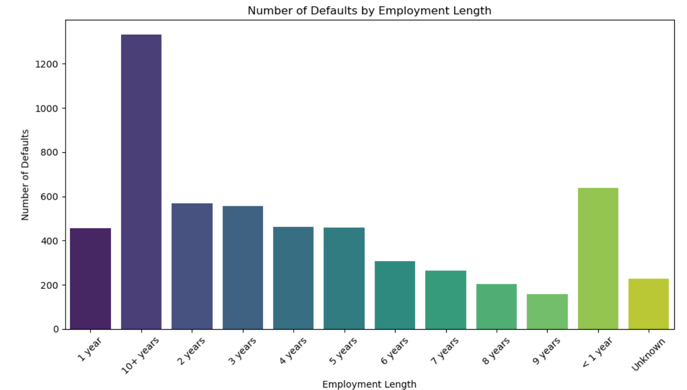
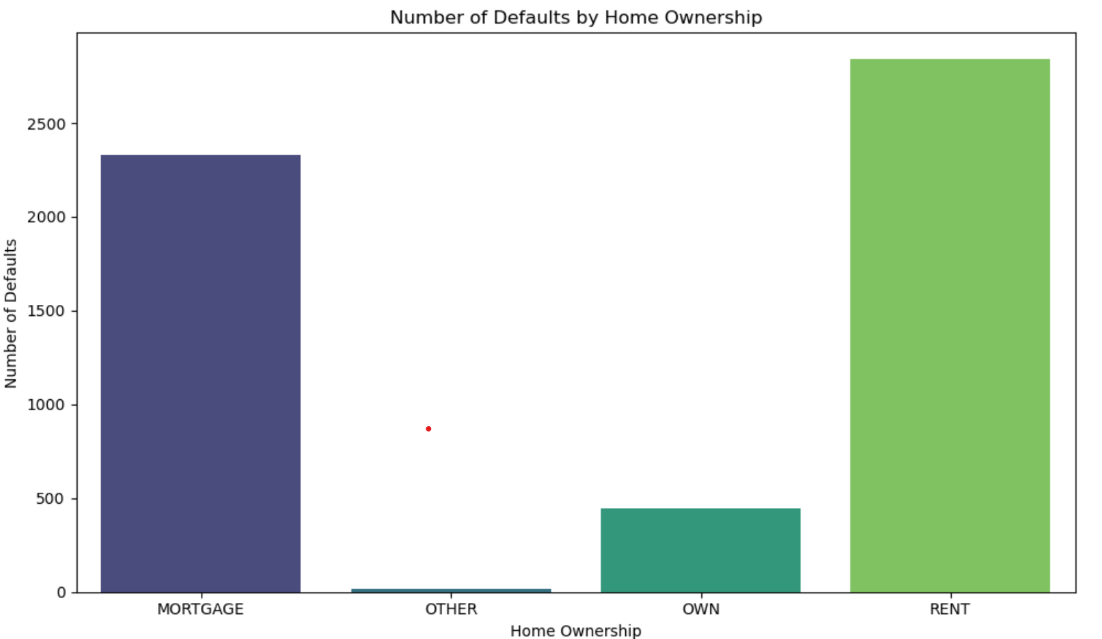
Univariant Analysis Report
These are the detail Univariant analysis for defaulter

Slide 6
Univariant Analysis Summary
parameters | Country/state code | Purpose of Loan | Term /Tenure of loan | DTI Bucket | Employment service | Home ownership
Risky /Defaulters | California( CA) | Debt consolidation | 36 Months | < 25 | >10 years of experience | Rent /Mortgage
Non Risky /Non defaulters | Other states | others | 60 Months | Others | others | others

Slide 7
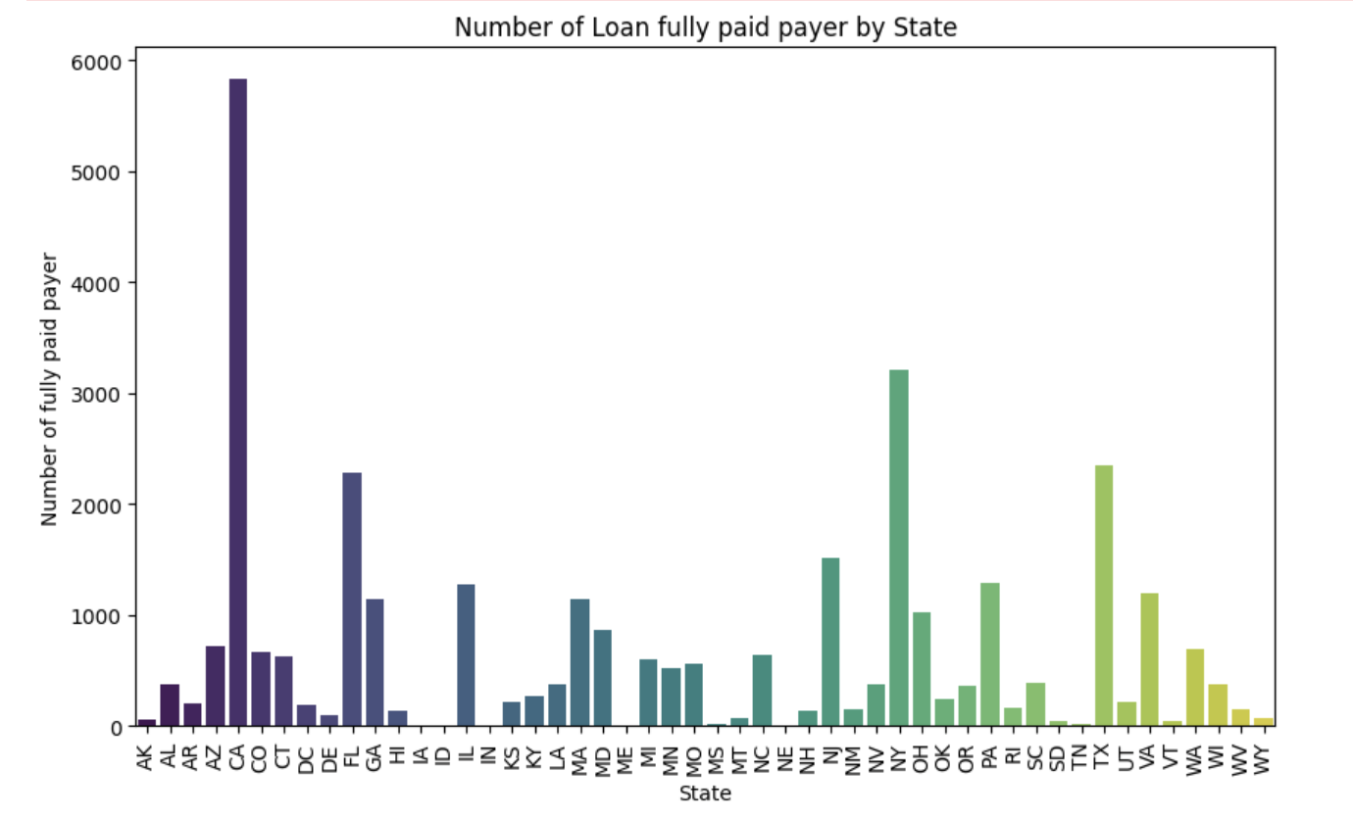
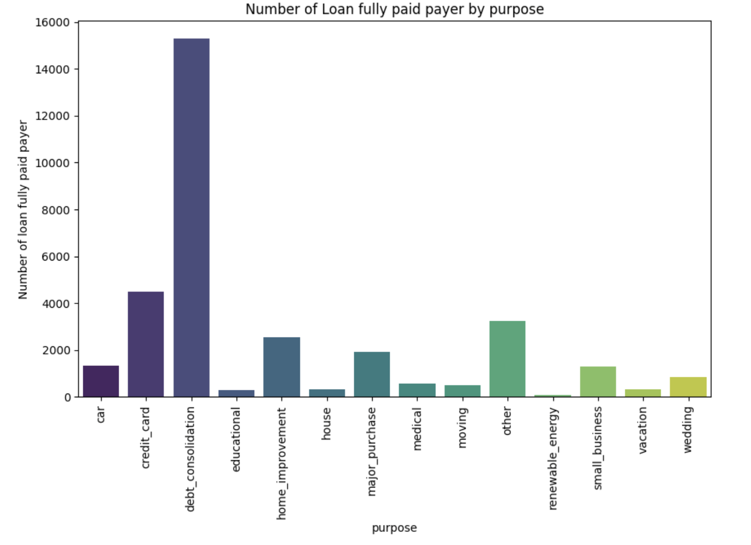

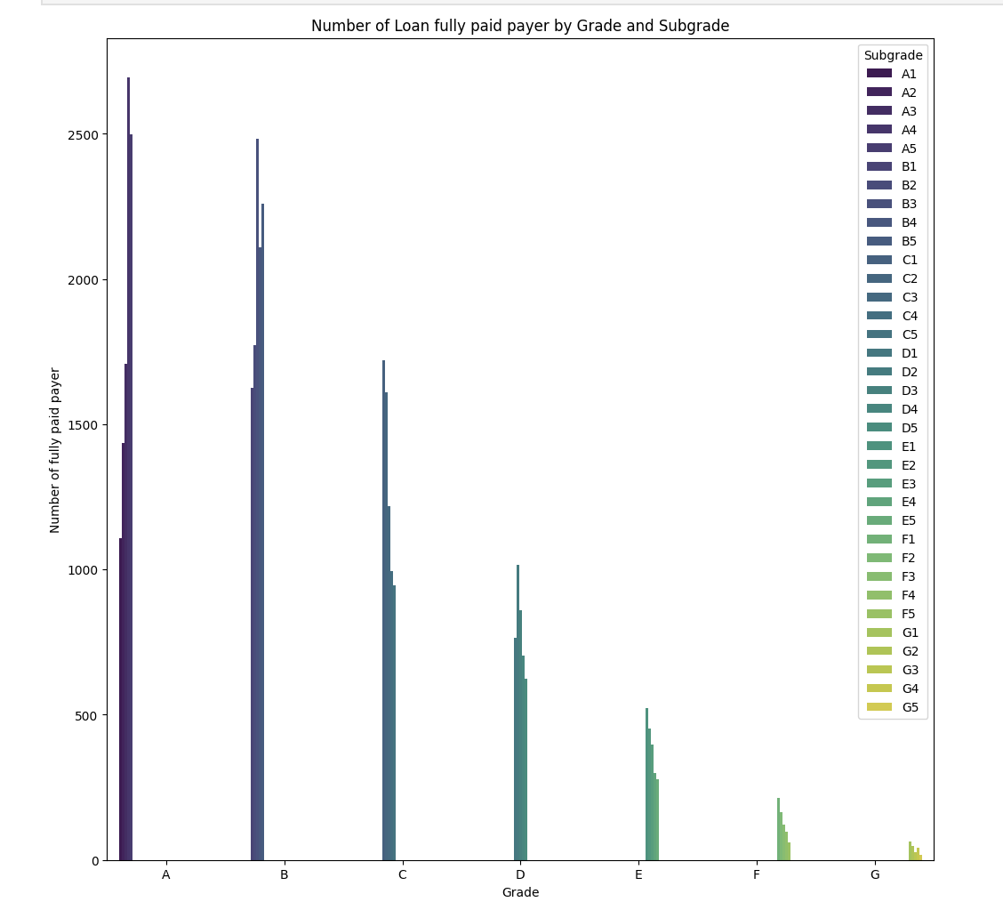
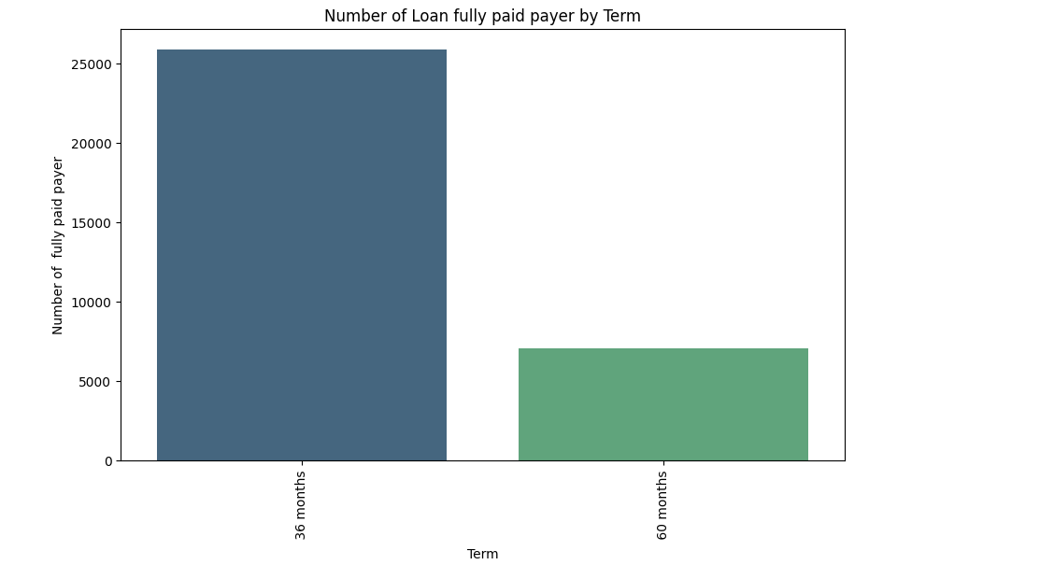
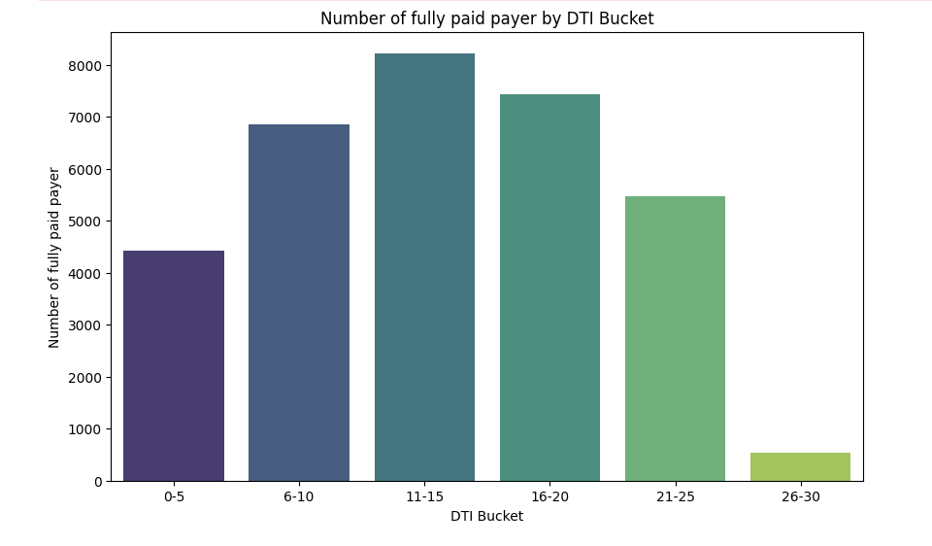
Univariant Analysis Report
These are the detail Univariant analysis for fully paid lender

Slide 8
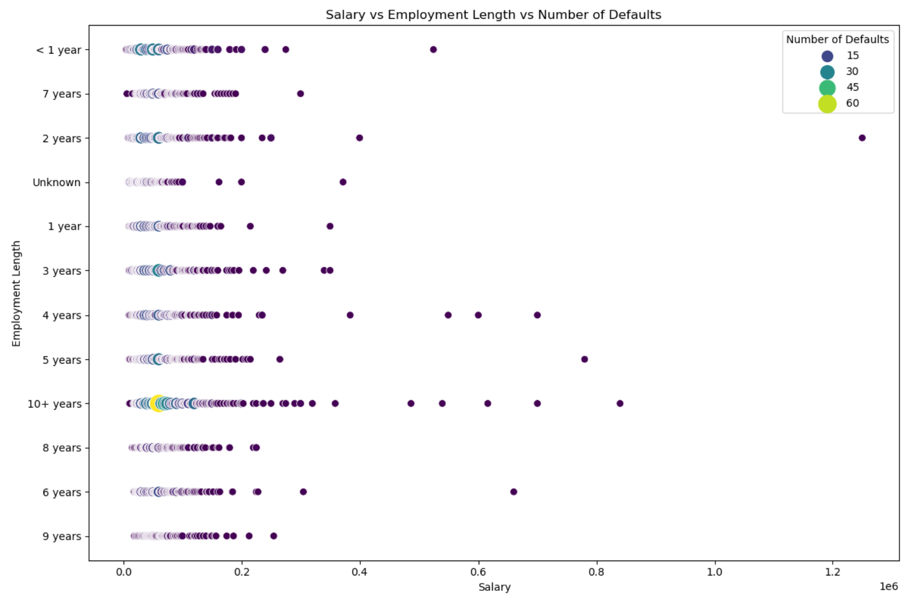
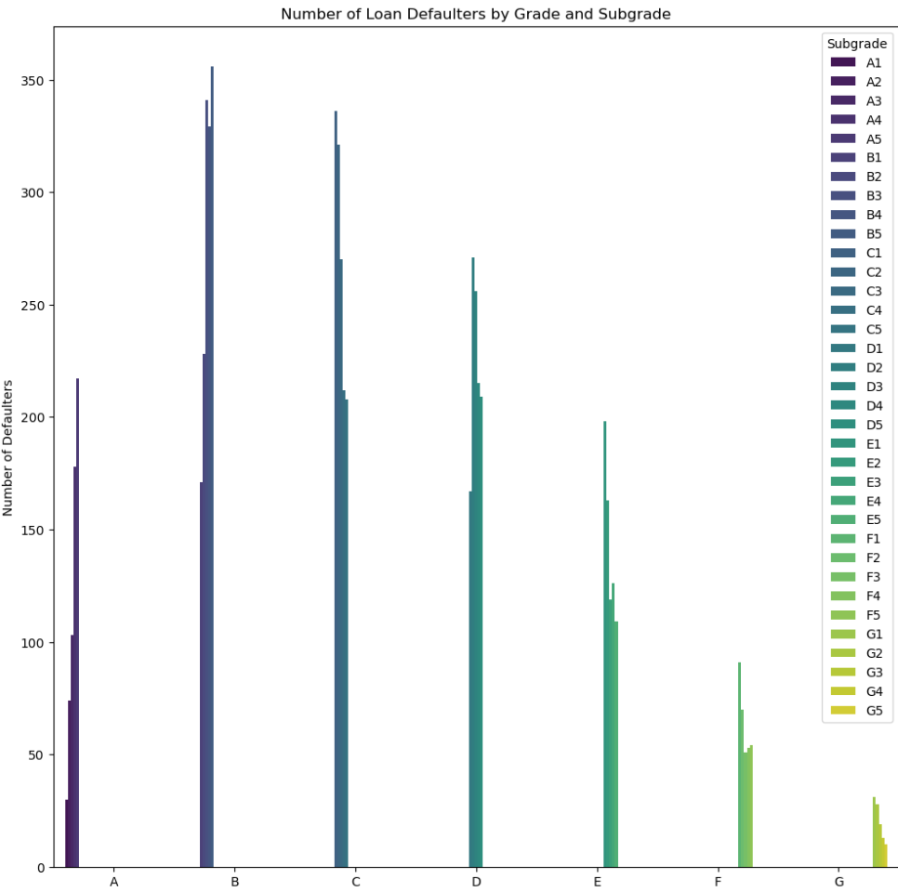
Bivariant Analysis & Summary
 | Salary & years of experience | Grade and subgrade
Risky /Defaulters | Low salary and high years of experience | Except G grade and its sub grade
Non Risky/Non Defaulters | High salary and less years of experience | Only G grade and its sub grades

Slide 9
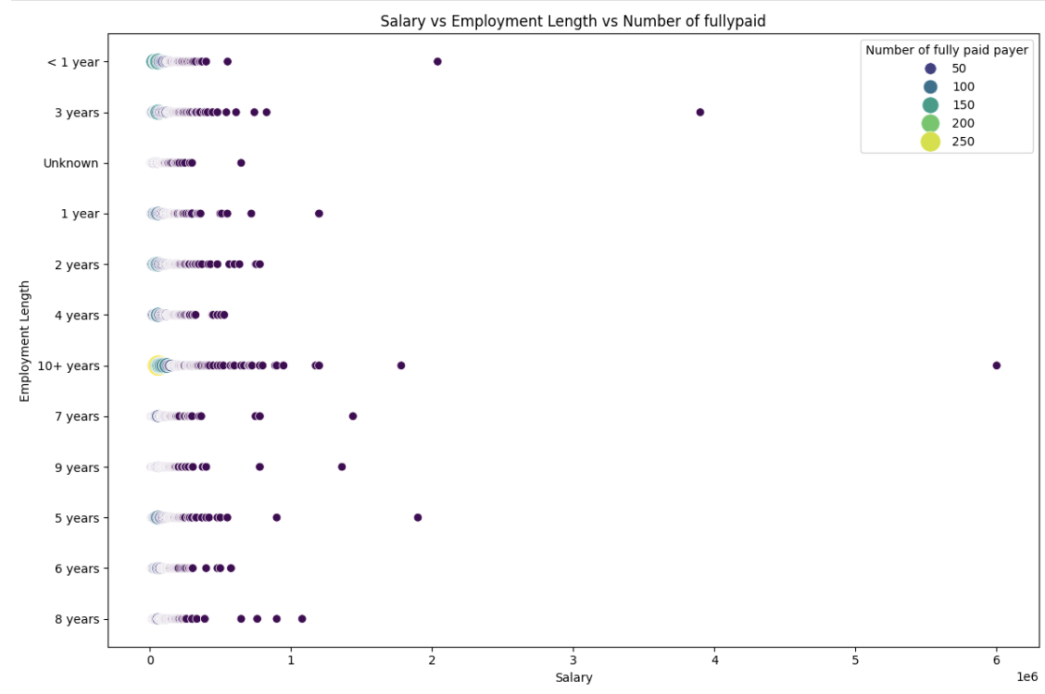
Bivariant Analysis & Summary
 | Salary & years of experience | Grade and subgrade
Paid on time | People who has less than experience 10+ has paid most of the loans | Except G grade and its sub grade
Non Risky/Non Defaulters

Slide 10

Any questions ?

Slide 11

Thank You

